Slide 1


Waterfall Charts
Marketing is the study and management of exchange relationships. Marketing is the business process of creating relationships with and satisfying customers.
2019 Actual
43.7M
Net Profit +3% up
2020 Actual
65.4M
Net Profit +3% up

Slide 2

Waterfall Charts
Marketing is the study and management of exchange relationships. Marketing is the business process of creating relationships with and satisfying customers.
Sales
Taxes
Returns
Bonuses
Results
Online Sales

Slide 3
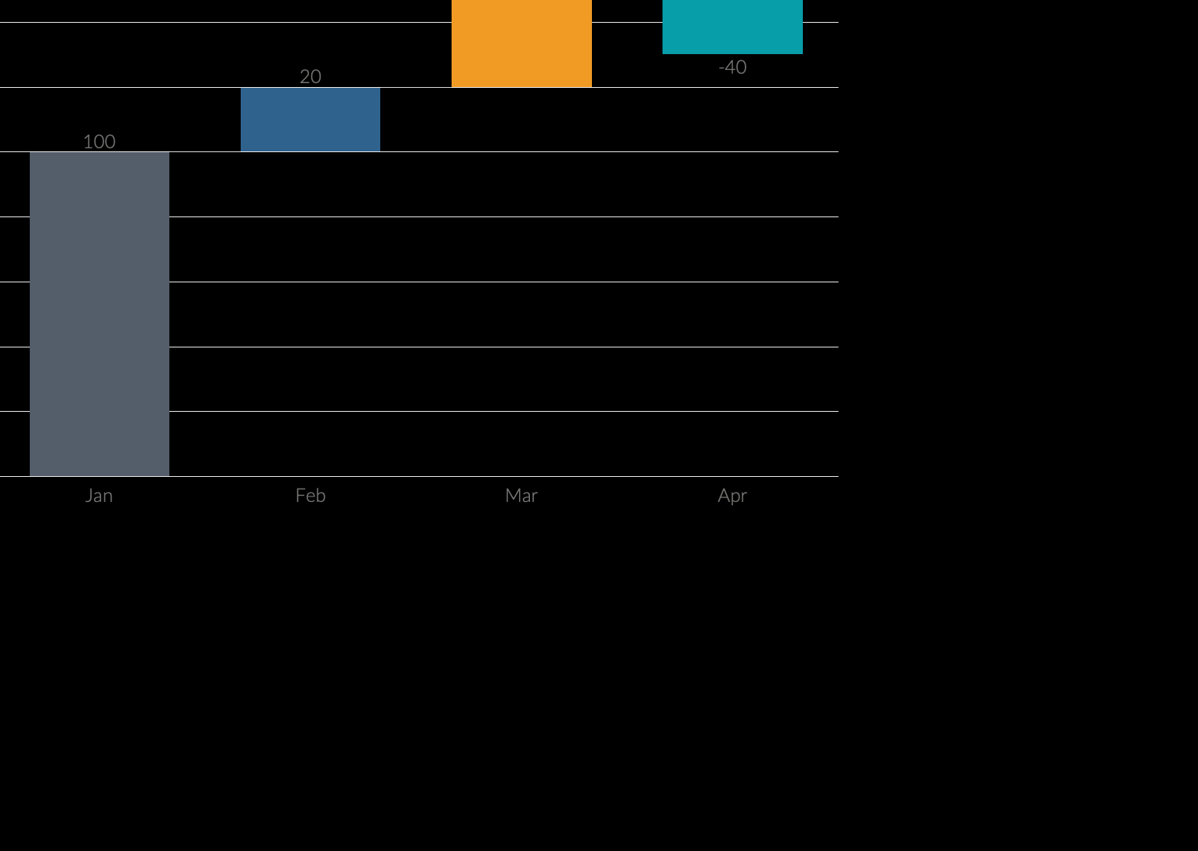
Waterfall Charts
Marketing is the study and management of exchange relationships. Marketing is the business process of creating relationships with and satisfying customers.
2020 Actual
265.74M
There are people who have a significant number of followers in every business domain on social media.
These influencers create detailed content that provides useful information.

Slide 4
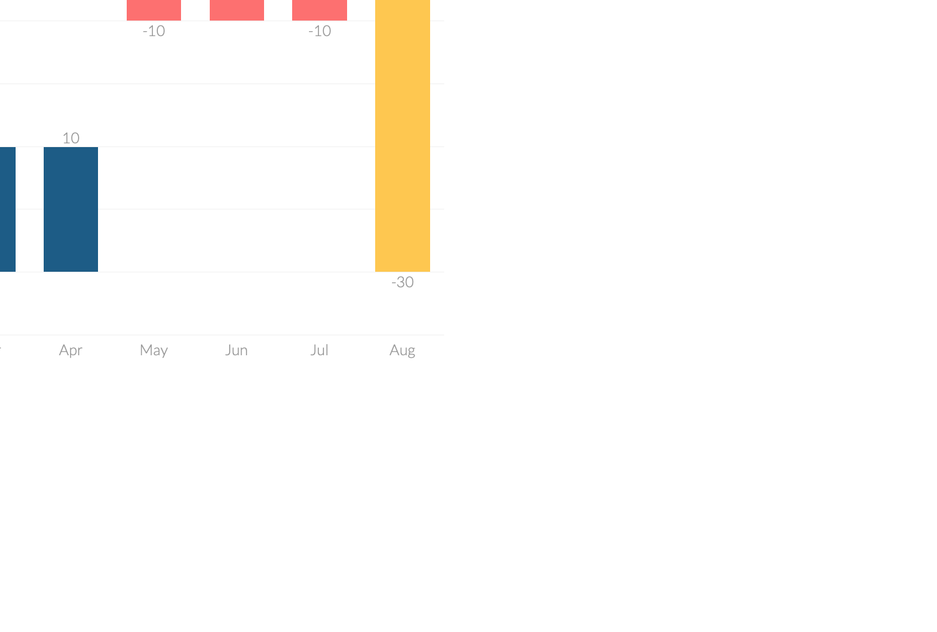
Waterfall Charts
Marketing is the study and management of exchange relationships. Marketing is the business process of creating relationships with and satisfying customers.
+23
Increase
To get your company’s name out there, you need to make sure marketing.
+17
Decrease
To get your company’s name out there, you need to make sure marketing.

Slide 5
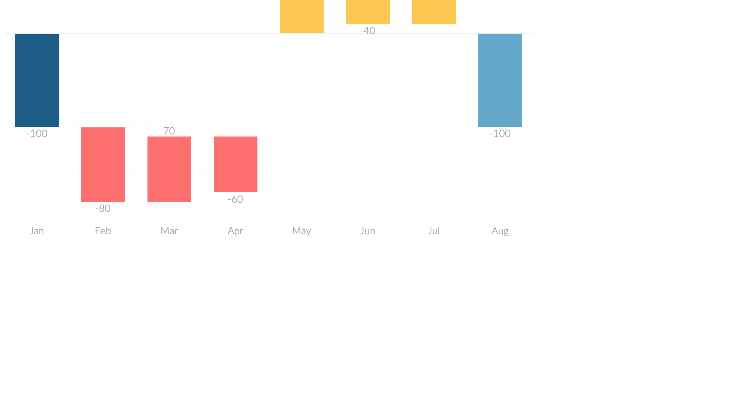
Waterfall Charts
Marketing is the study and management of exchange relationships. Marketing is the business process of creating relationships with and satisfying customers.
Sales
To get your company’s name out there, you need to make sure.
Bonuses
To get your company’s name out there, you need to make sure.
Returns
To get your company’s name out there, you need to make sure.
Taxes
To get your company’s name out there, you need to make sure.

Slide 6
Waterfall Charts
Marketing is the study and management of exchange relationships. Marketing is the business process of creating relationships with and satisfying customers.
Write Your Title
Write Your Title
There are people who have a significant number of followers in every business domain on social media.
Increase
Decrease

Slide 7
Waterfall Charts
Marketing is the study and management of exchange relationships. Marketing is the business process of creating relationships with and satisfying customers.
Write Your Title
Write Your Title
Write Your Title
Write Your Title
Increase
Decrease
Increase
Decrease

Slide 8

Waterfall Charts
Marketing is the study and management of exchange relationships. Marketing is the business process of creating relationships with and satisfying customers.
Write Your Title
Write Your Title
Business Model
0.36%
Increase
Decrease

